Slide 1
Combinational Circuits
By J.J.N.D Harshitha
Kasura Technologies Private Limited

Slide 2
contents
Introduction
Classification of combinational logic
Applications

Slide 3
Introduction
Combinational circuit is a circuit in which we combine the different gates in the circuit, for example encoder, decoder, Multiplexer and Demultiplexer. Some of the characteristics of combinational circuits are following −
The output of combinational circuit at any instant of time, depends only on the levels present at input terminals.
The combinational circuit do not use any memory. The previous state of input does not have any effect on the present state of the circuit.
A combinational circuit can have an n number of inputs and m number of outputs.

Slide 4
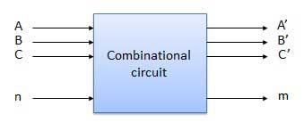
Block Diagram

Slide 5
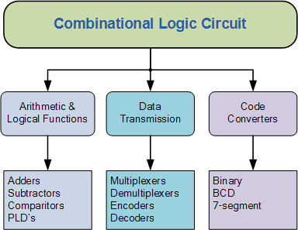
Classification of combinational logic

Slide 6
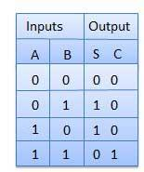
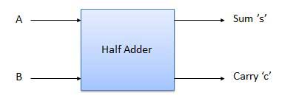
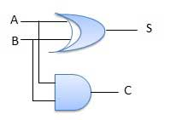
Half Adder
Half adder is a combinational logic circuit with two inputs and two outputs. The half adder circuit is designed to add two single bit binary number A and B. It is the basic building block for addition of two single bit numbers. This circuit has two outputs carry and sum.

Slide 7
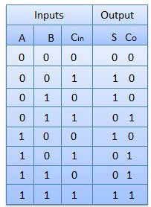
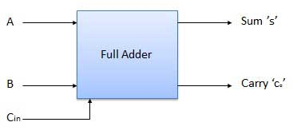
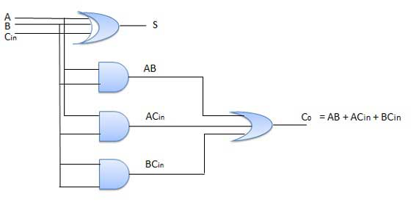
Full Adder
Full adder is developed to overcome the drawback of Half Adder circuit. It can add two one-bit numbers A and B, and carry c. The full adder is a three input and two output combinational circuit.

Slide 8
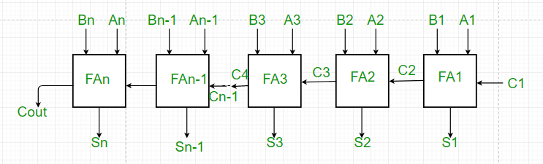
N-Bit Parallel Adder
The Full Adder is capable of adding only two single digit binary number along with a carry input. But in practical we need to add binary numbers which are much longer than just one bit. To add two n-bit binary numbers we need to use the n-bit parallel adder. It uses a number of full adders in cascade. The carry output of the previous full adder is connected to carry input of the next full adder.

Slide 9
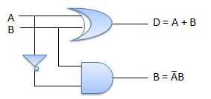
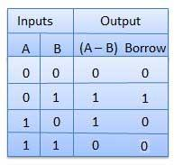
Half Subtractor
Half subtractor is a combination circuit with two inputs and two outputs (difference and borrow). It produces the difference between the two binary bits at the input and also produces an output (Borrow) to indicate if a 1 has been borrowed. In the subtraction (A-B), A is called as Minuend bit and B is called as Subtrahend bit.

Slide 10
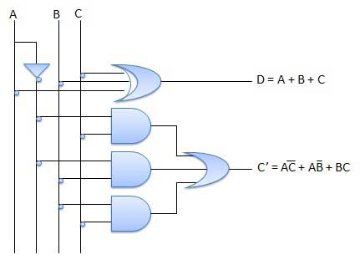
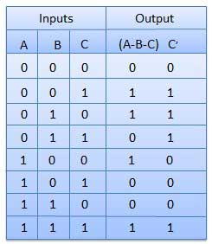
Full Subtractor
The disadvantage of a half subtractor is overcome by full subtractor. The full subtractor is a combinational circuit with three inputs A,B,C and two output D and C'. A is the 'minuend', B is 'subtrahend', C is the 'borrow' produced by the previous stage, D is the difference output and C' is the borrow output.

Slide 11
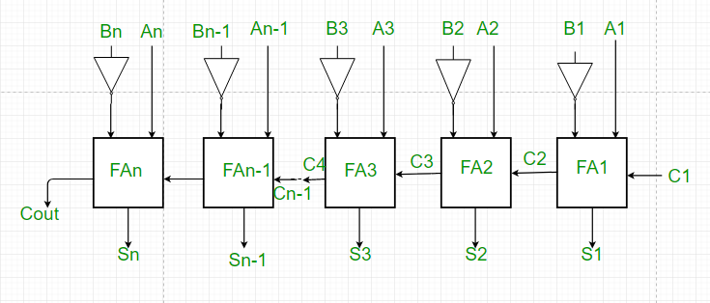
N-Bit Parallel Subtractor
The subtraction can be carried out by taking the 1's or 2's complement of the number to be subtracted. For example we can perform the subtraction (A-B) by adding either 1's or 2's complement of B to A. That means we can use a binary adder to perform the binary subtraction.

Slide 12
Multiplexer
Multiplexer is a special type of combinational circuit. There are n-data inputs, one output and m select inputs with 2m = n. It is a digital circuit which selects one of the n data inputs and routes it to the output. The selection of one of the n inputs is done by the selected inputs. Depending on the digital code applied at the selected inputs, one out of n data sources is selected and transmitted to the single output Y. E is called the strobe or enable input which is useful for the cascading. It is generally an active low terminal that means it will perform the required operation when it is low.

Slide 13
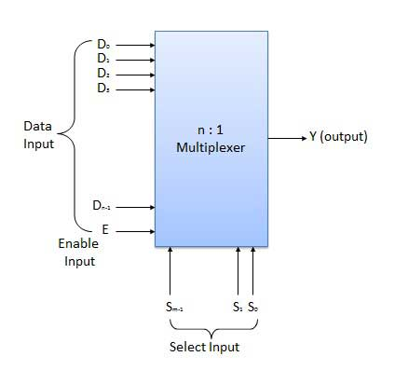
Block Diagram

Slide 14
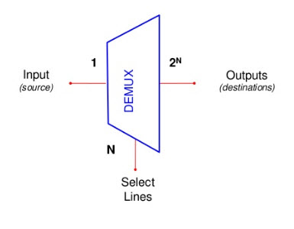
Demultiplexer
A demultiplexer performs the reverse operation of a multiplexer i.e. it receives one input and distributes it over several outputs. It has only one input, n outputs, m select input. At a time only one output line is selected by the select lines and the input is transmitted to the selected output line. A de-multiplexer is equivalent to a single pole multiple way switch.

Slide 15
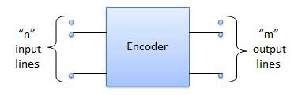
Encoder
Encoder is a combinational circuit which is designed to perform the inverse operation of the decoder. An encoder has n number of input lines and m number of output lines. An encoder produces an m bit binary code corresponding to the digital input number. The encoder accepts an n input digital word and converts it into an m bit another digital word.

Slide 16
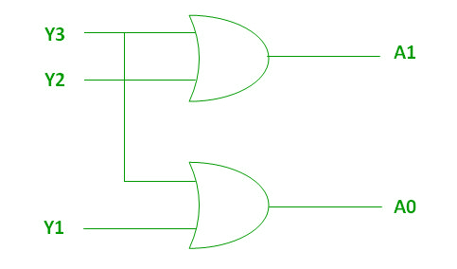
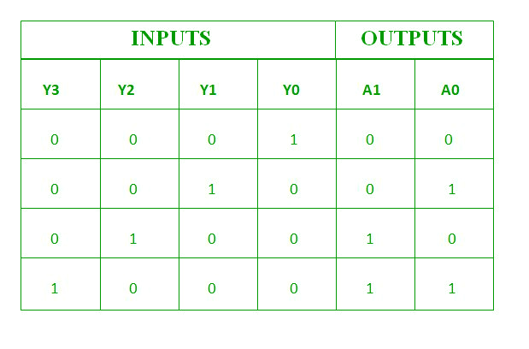
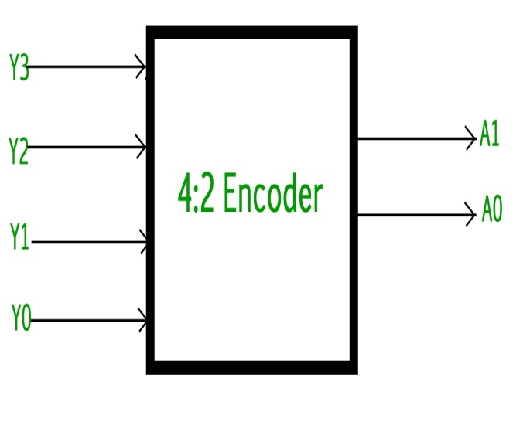
Example for Encoder
4 t0 2 Line encoder : The 4 to 2 Encoder consists of four inputs Y3, Y2, Y1 & Y0 and two outputs A1 & A0. At any time, only one of these 4 inputs can be ‘1’ in order to get the respective binary code at the output.

Slide 17
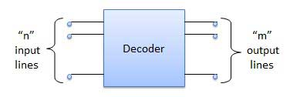
Decoder
A decoder is a combinational circuit. It has n input and to a maximum m = 2n outputs. Decoder is identical to a demultiplexer without any data input. It performs operations which are exactly opposite to those of an encoder.

Slide 18
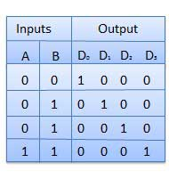
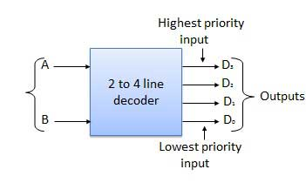
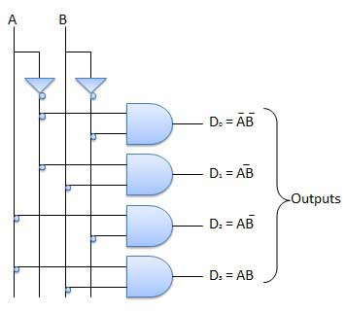
Example for Decoder
2 to 4 Line Decoder : The block diagram of 2 to 4 line decoder. A and B are the two inputs where D through D are the four outputs. Truth table explains the operations of a decoder. It shows that each output is 1 for only a specific combination of inputs.

Slide 19
Applications
Digital measuring Techniques
Digital Processing
Industrial Processing
Computers
Calculators
Digital communication

Slide 20


